Slide 1
Bike Sharing Trends in the United States
INFM600 Final Presentation
Team Makers: Ankit Dhall, Kankshi Dhar, Mayhah Suri
December 13th, 2018

Slide 2
Presentation Outline
Introduction
Research Questions
Data
Analysis: Trends
Analysis: Recommendations

Slide 3
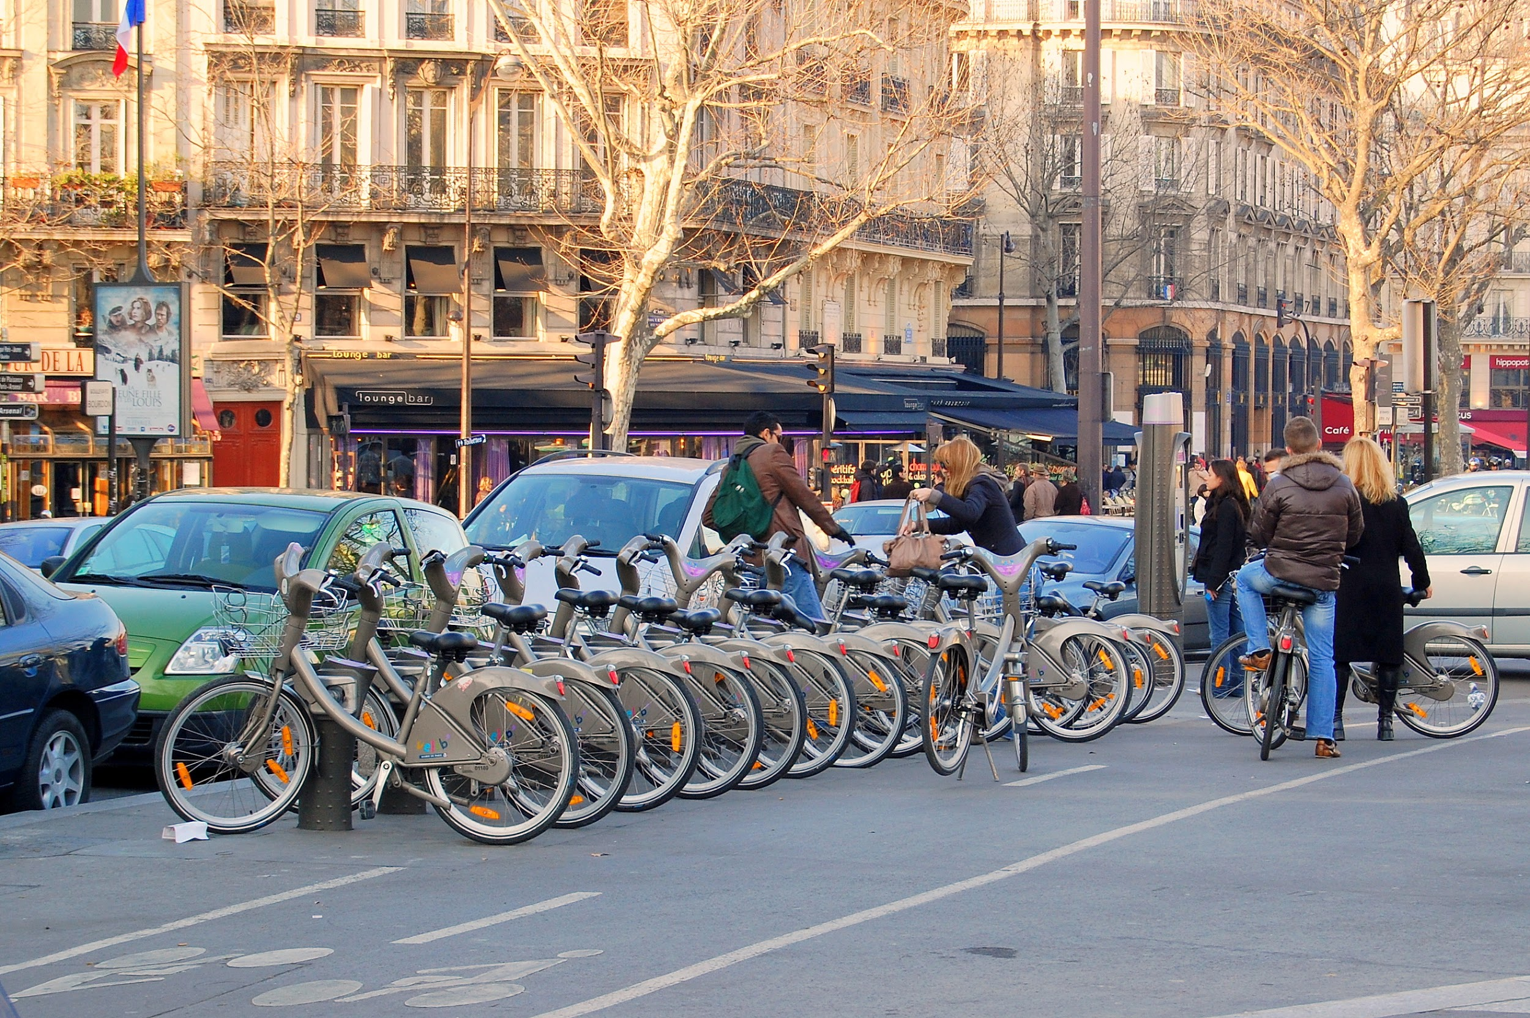
What is bike share or bike sharing?
Short term bicycle rental
User rents at unmanned station and returns at the same or different rack
Some systems are dockless, which requires users to have an app on their smartphones
Most systems offer memberships in addition to one-day and multi-day passes.
Bike sharing system in Paris, France. By Pline - Own work, CC BY-SA 3.0, https://commons.wikimedia.org/w/index.php?curid=4164593

Slide 4
Introduction
Seattle recently completed a bike share pilot program for a dockless system
Currently evaluating and considering full implementation of a new system
Pilot program was controversial and had mixed results

Slide 5

Problem:
City of Seattle wants a bike share system and does not have one.
Our solution:
Review bike share programs in three major U.S. cities and provide recommendations to Seattle Department of Transportation (SDOT) based on those programs.
Bike image from
https://commons.wikimedia.org/wiki/File:USDOT_highway_sign_bicycle_symbol_-_black.svg

Slide 6
Seattle Profile
Population: 723, 745
Walkability Score: 73.1/100
Seattle is the “best bike city in America” according to Bicycling Magazine https://www.seattletimes.com/seattle-news/transportation/the-best-bike-city-in-america-thats-seattle-apparently/
building protected bike lanes,
lowering vehicle speed limits

Slide 7
Cities Reviewed
Chicago, Illinois
Los Angeles, California
Washington, D.C.
Population: 2.7 million
Walkability Score:
77.8/100
Population: 4 million
Walkability Score:
66/100
Population: 700k
Walkability Score:
77.3/100

Slide 8
Research Questions
What is the best system for Seattle?
Easily accessible for users (availability, convenient station location)
Easy to use (not impeding pedestrians, user-friendly)
Should the system be docked or dockless?
What is the basic profile of bike share systems in other major U.S. cities?
Rides and usage
Weather impacts
Ridership demographics

Slide 9
Data
Data made publicly available by respective municipalities
Published monthly and quarterly
Used data sets to examine trends in bike share programs in the three cities
Weather data from Weather Underground

Slide 10

Audience
Seattle Department of Transportation
Core values for bike sharing system:
Support an active, healthy, and people first use of Seattle’s streets
Ensure affordable and equitable service—particularly for cost-burdened communities of color—while expanding access to Opportunities
Fill mobility gaps and improve connections to transit
Be safe and advance our Vision Zero objectives
Provide a low-carbon mobility option as part of Seattle’s efforts to reduce carbon emissions
Manage public space to ensure sidewalks are organized and free from obstructions
Derive insights into how people use the system, compliance issues, and targeted bike infrastructure investments with robust data partnerships.
From 2017 free-floating bike share pilot evaluation report, SDOT 2018
From Seattle Dept. of Transportation

Slide 11
Results: Basics
How long is the average ride?
LA - 36.79 minutes
DC - 20.82 minutes
CG - 24.21 minutes
Age range of users?
Average- 35.37 years
Min- 15 years
Max- 85 years
How many bikes in the fleet?
LA - 1398
DC - 4505
CG - not available

Slide 12
Bikeshare Trends

Slide 13
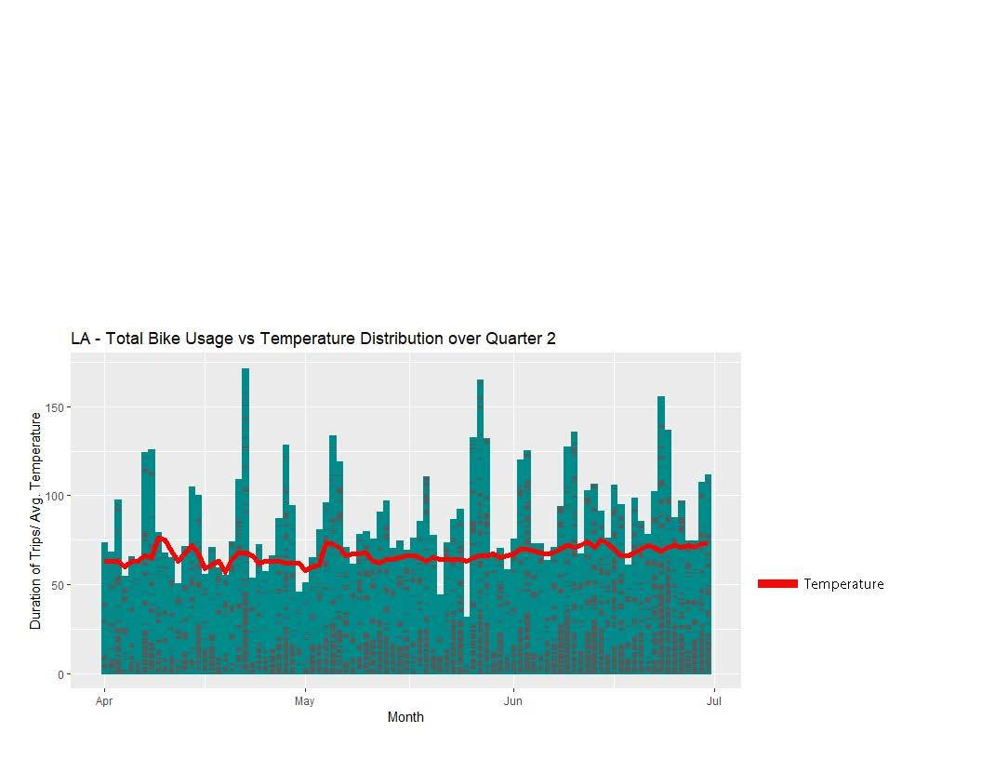

Slide 14
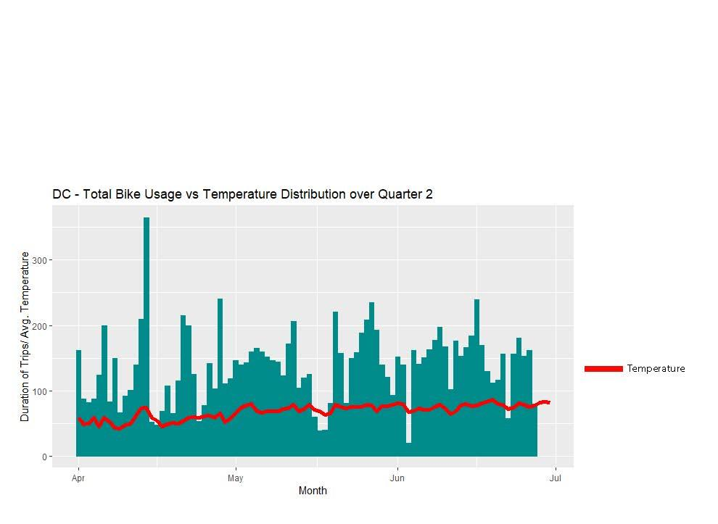

Slide 15
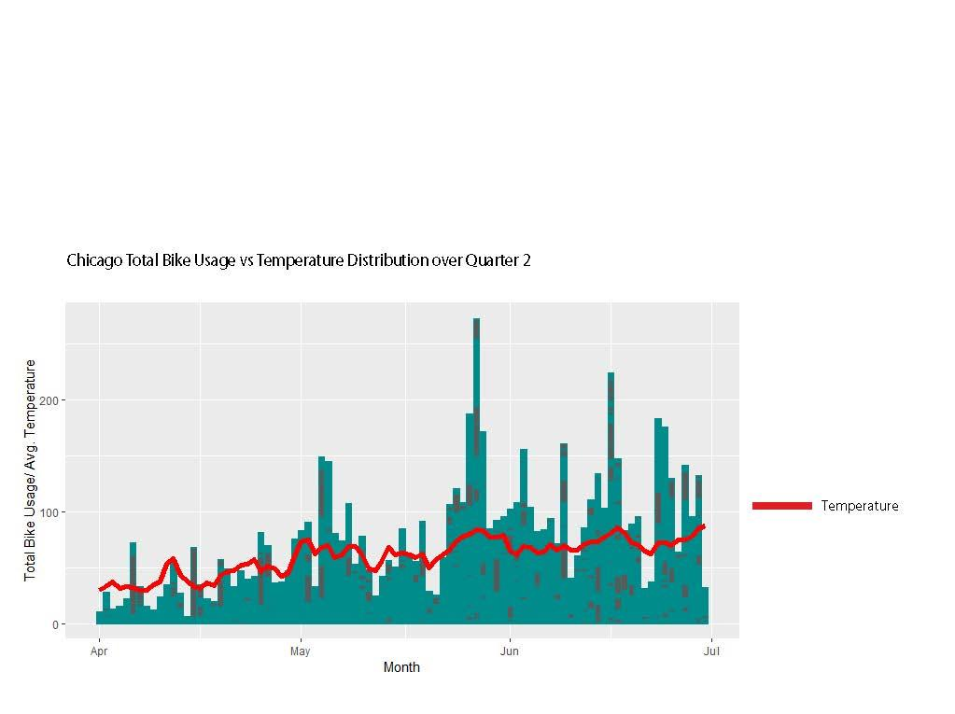

Slide 16
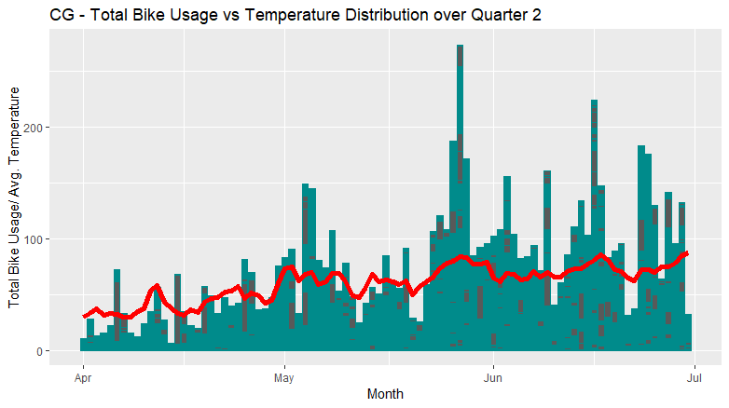
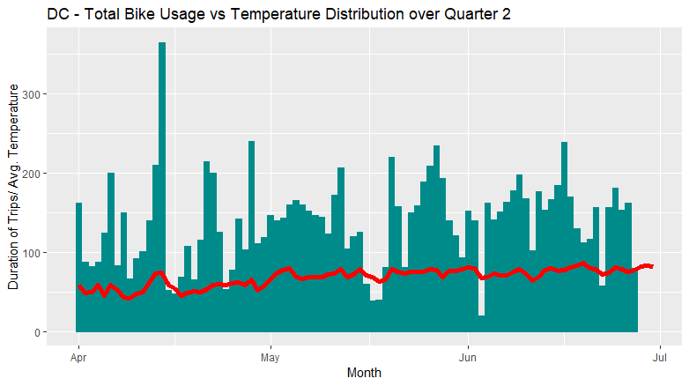
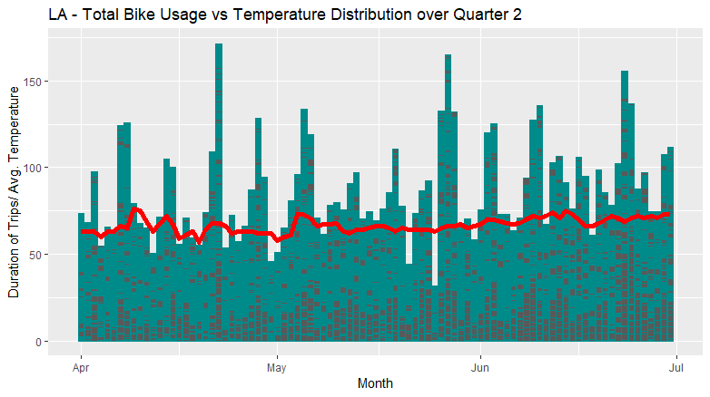

Slide 17
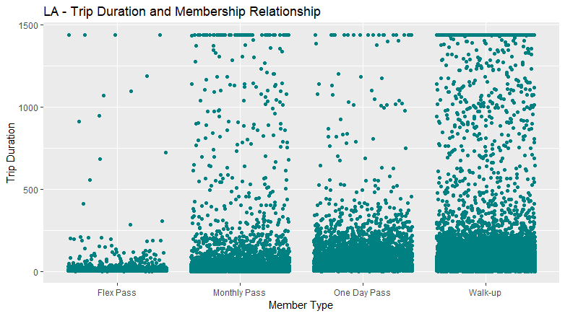

Slide 18
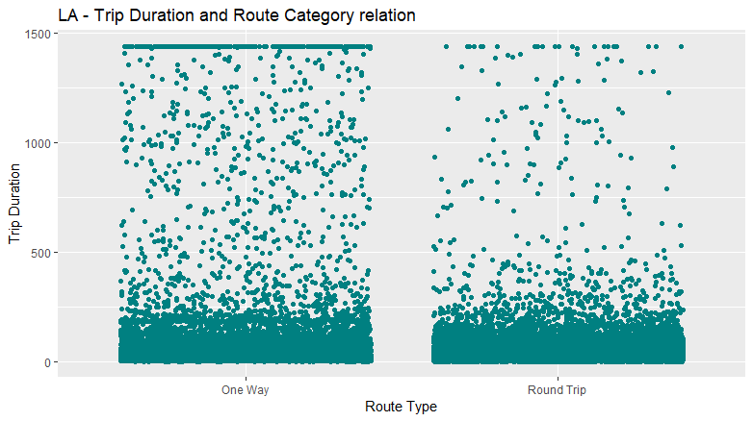

Slide 19
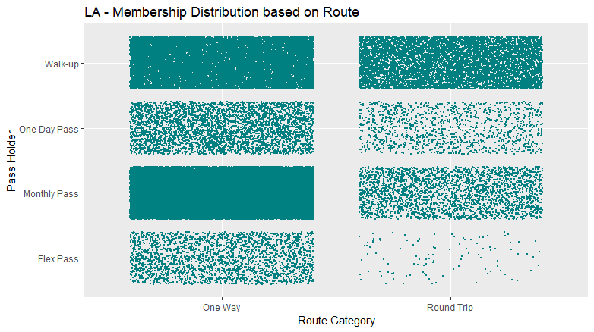

Slide 20
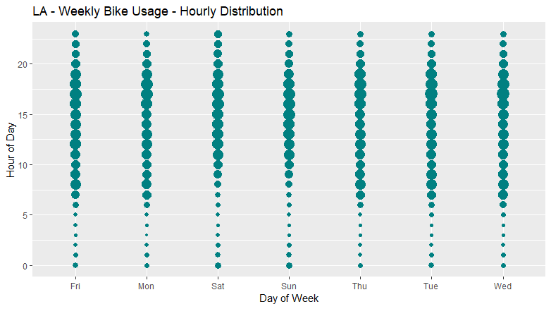

Slide 21
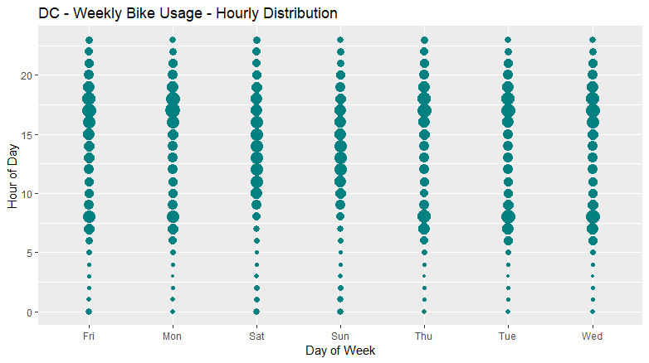

Slide 22
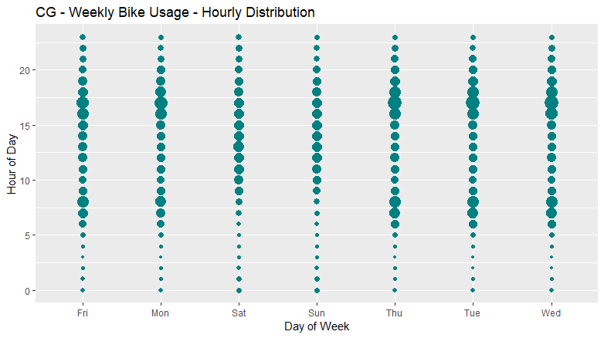

Slide 23
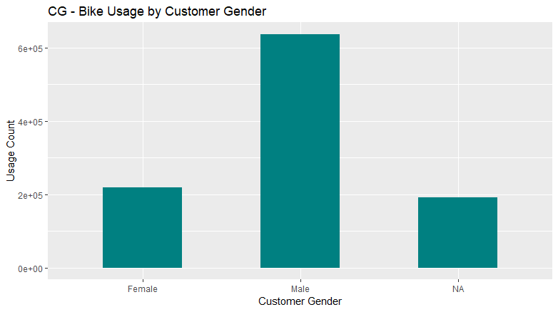

Slide 24
Recommendations

Slide 25
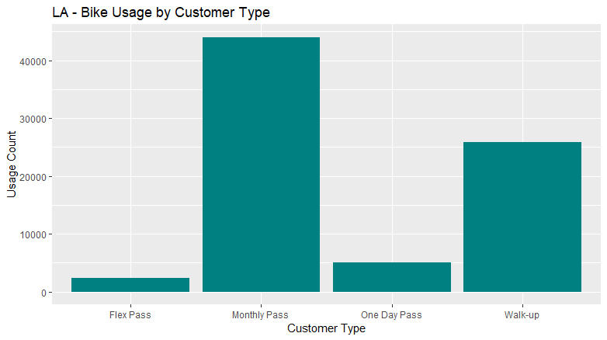

Slide 26
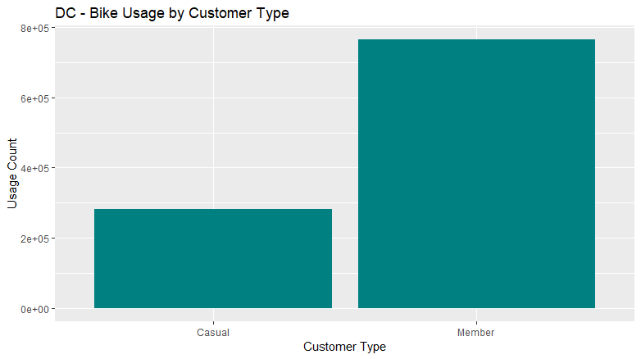

Slide 27
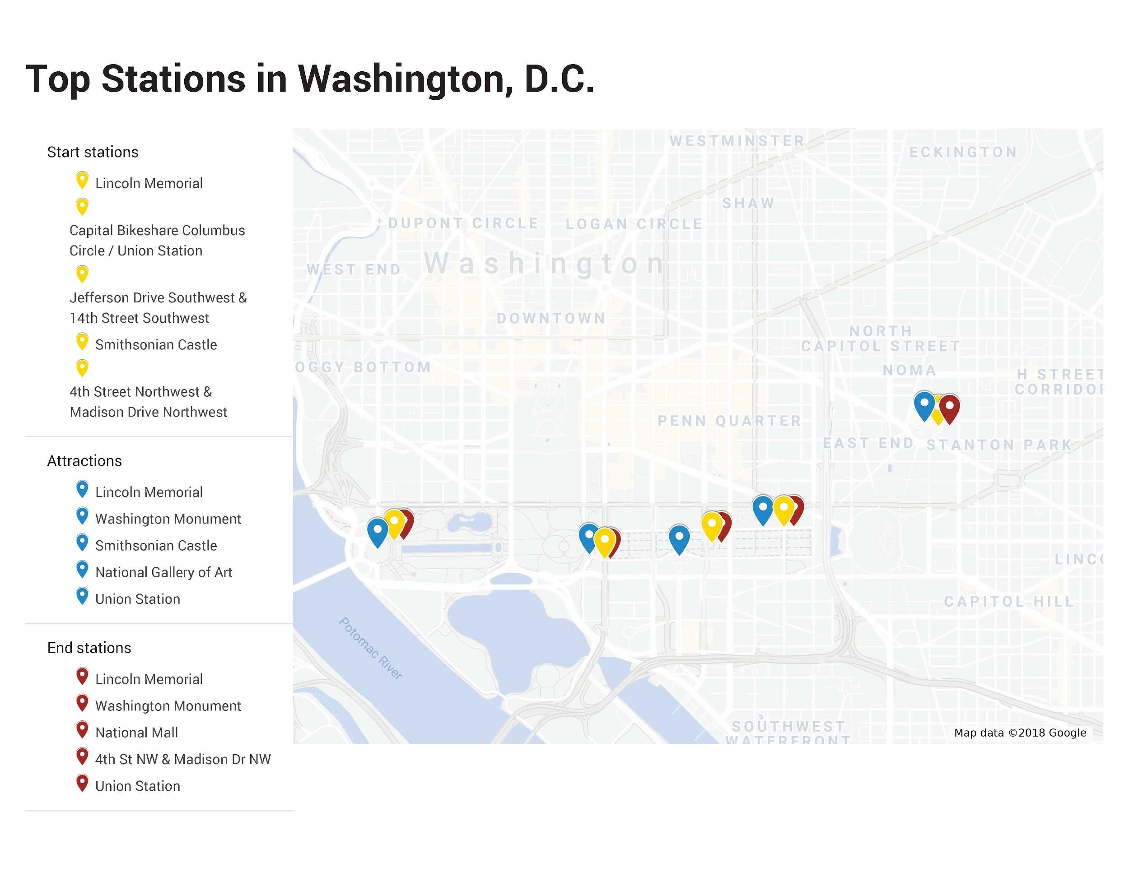
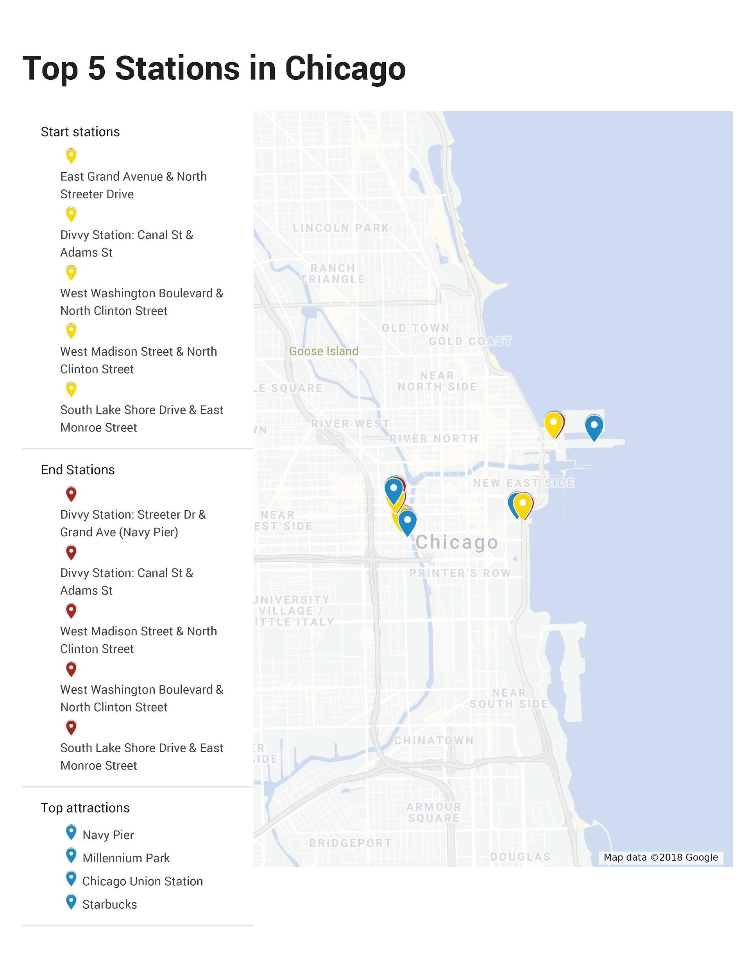
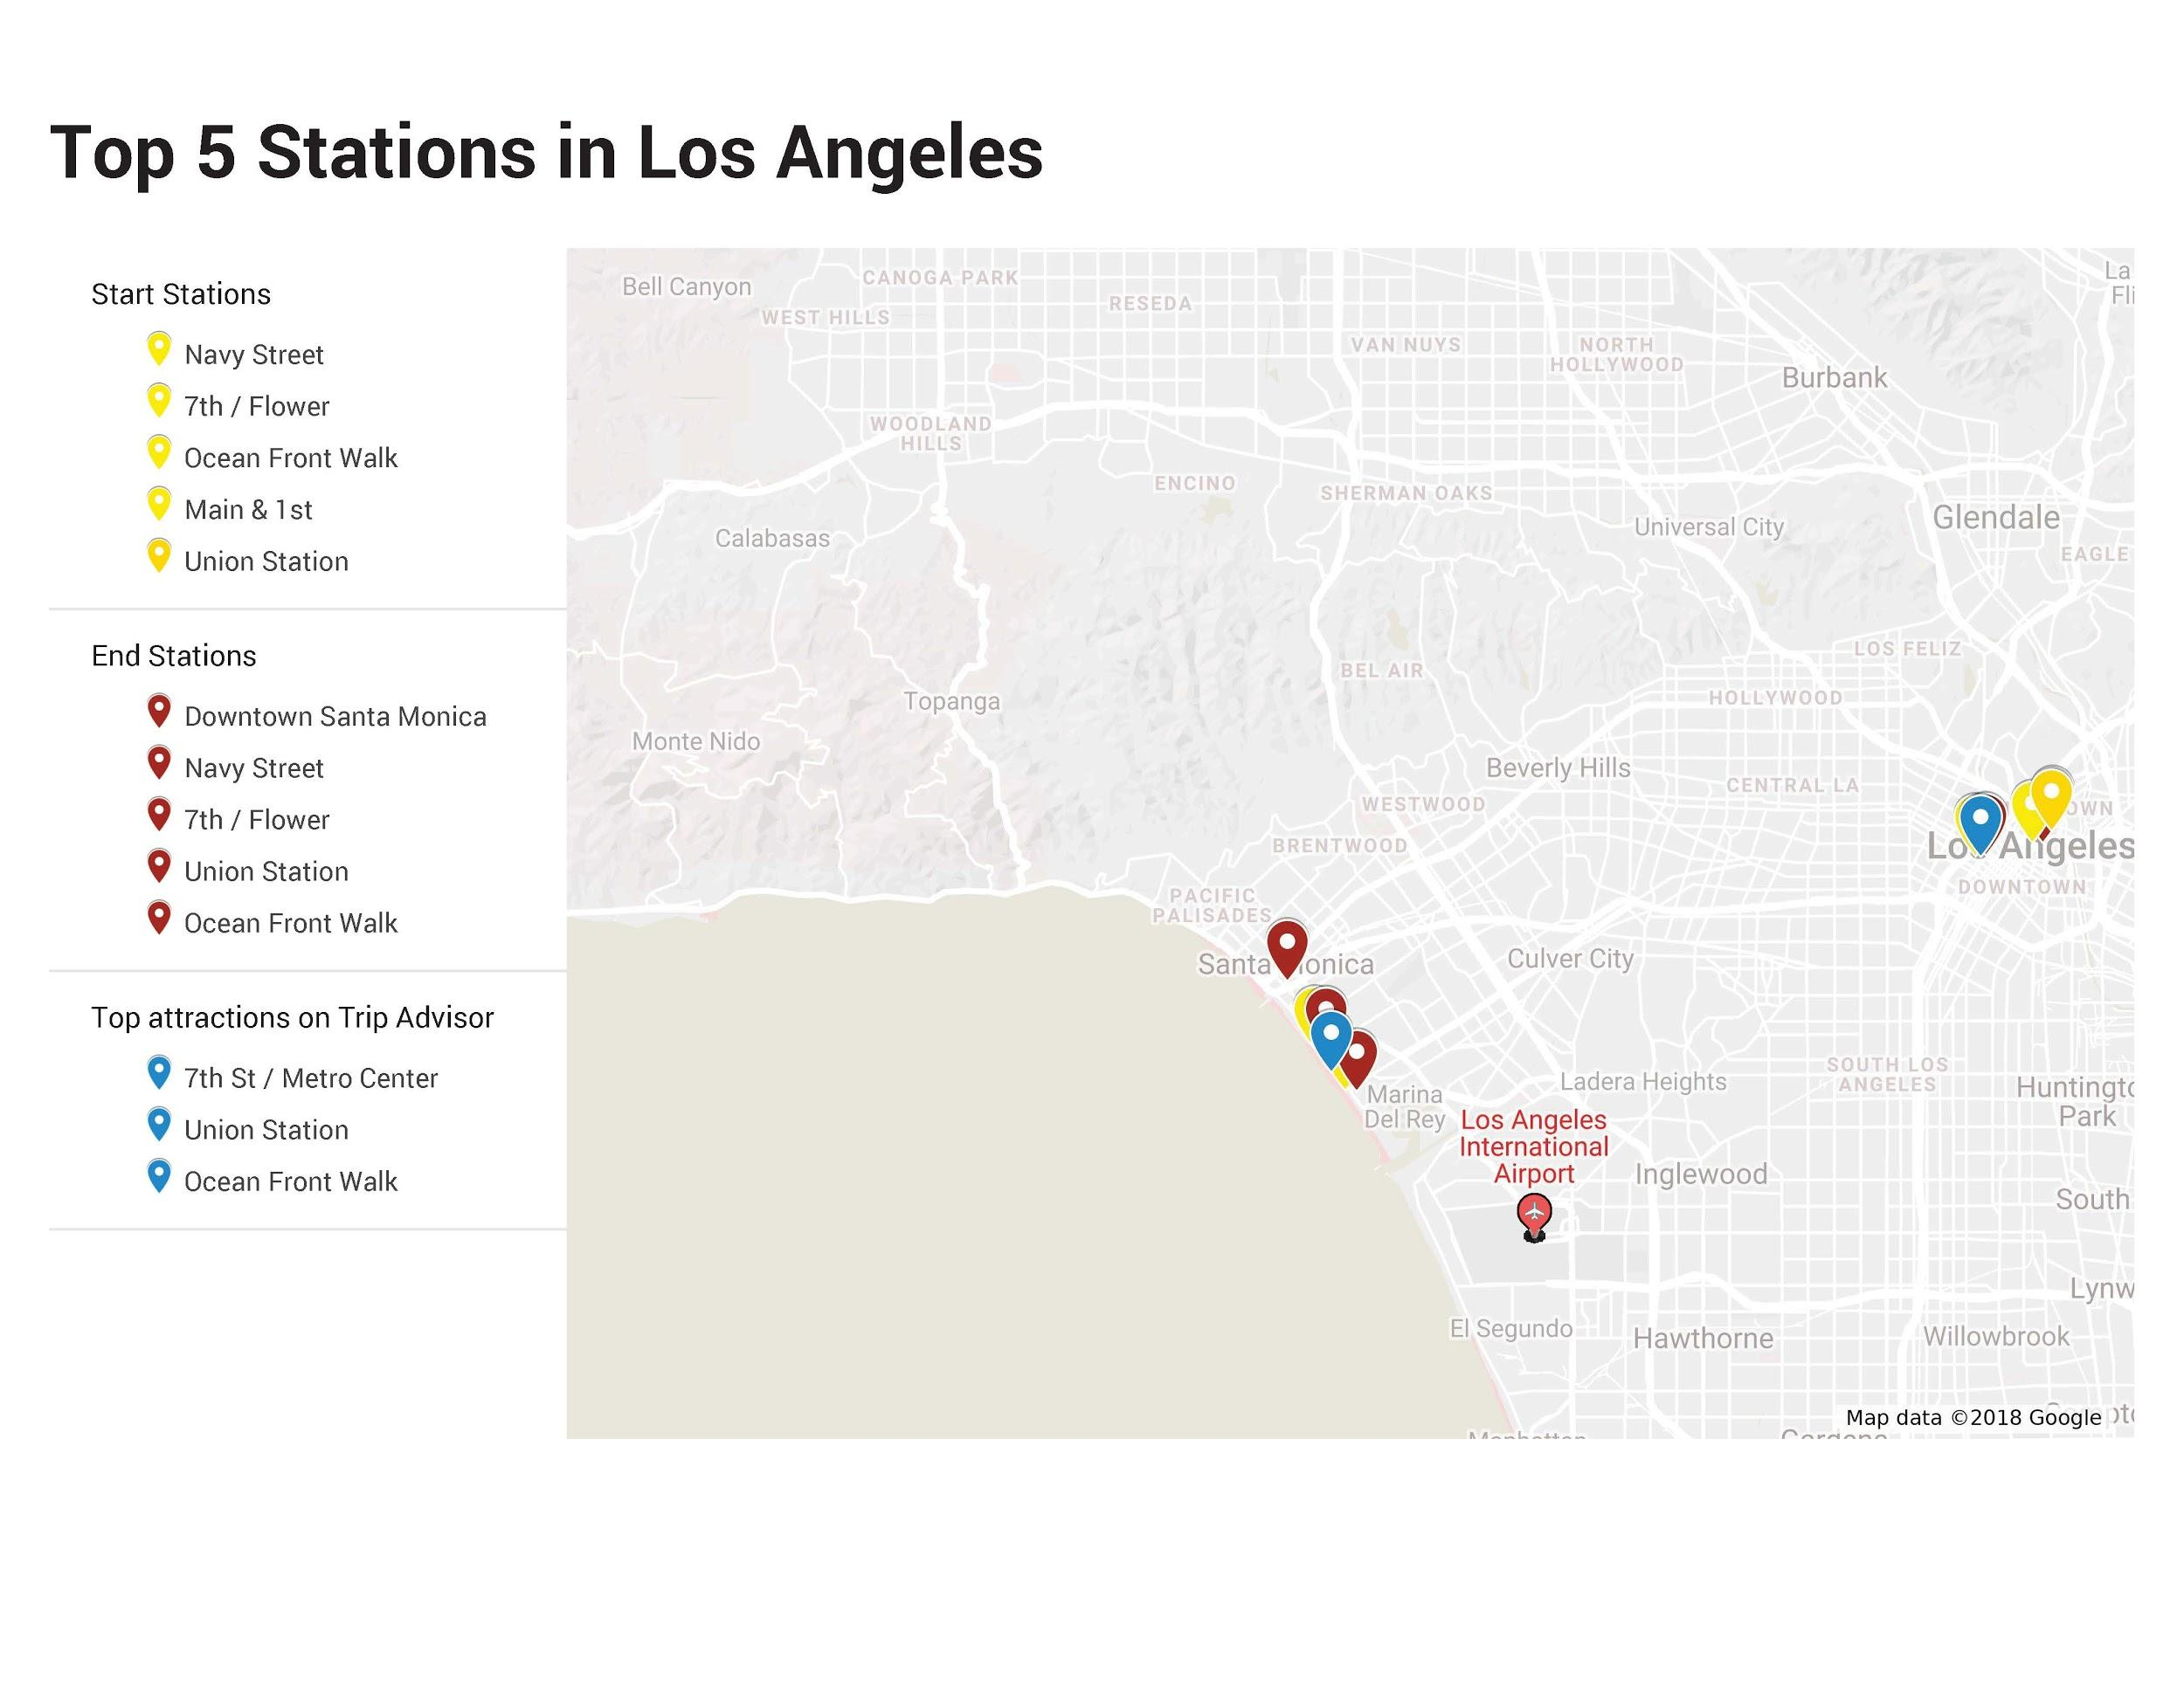

Slide 28
What is the best system for Seattle?
Easily accessible for users:
As we have seen in visualizations before, the hourly distributions v/s week shows a homogenous pattern during the week and a scattered pattern in the weekend. We see that Bike users mostly are very active during the office rush hours that begin from morning 6 am to 10am and then again from 3pm to 8pm on the weekdays. On weekends, it’s quite the opposite. On Saturdays and Sundays, there is a uniform pattern of bike usage from 9am to 8pm roughly.
Our Recommendation:
Increase the number of bikes on share spots near subways, tourist spots, bus stops since a lot of working class and tourists are using these bikes. These spots should house the most bikes as these will be the most convenient station locations

Slide 29
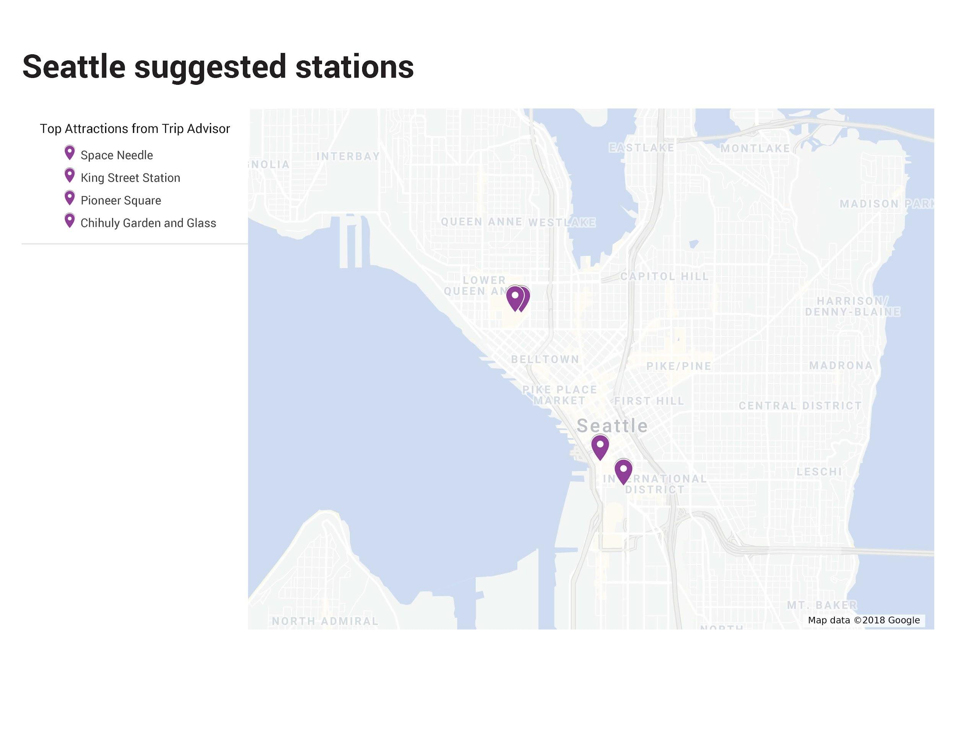
Recommendation: Station locations

Slide 30
What is the best system for Seattle?
User Types:
The monthly pass users make regular but short trips and the Walk-ups generally make the longer but vastly irregular trips. We have seen that the number of bike share users fall in these categories :
Monthly Pass
Walk-ups
One day and Flex Passes
Our Recommendation:
Based on personal experiences, we have seen that some bike-shares, such as Zagster, does not allow to user the bike share system unless you are a member, which effectively loses some customers. Our suggestion here would be that these Bikestops should have a card swipe system for walk-ups and easy locking and unlocking systems that would grant ease of use and be less time consuming as everyone uses it in rush hours mostly.

Slide 31
Should the system be docked or dockless?
The Seattle Bike Share system launched a pilot which was dockless. This led to losing a lot of bikes, Loss of bikes and several damages which effectively reduced the number of bikes available and was a contributing factor to their failure.
Our Recommendation:
Based on newspaper reports and citizen feedback, we recommend a docked system. The dockless system causes sidewalk blockages and impeded accessibility for people who use walking aids and wheelchairs. Using a dockless system would help in this scenario and also reduce the number of lost bikes or damages incurred because users would be accountable of what bike id they have on them after they swipe their credit cards.

Slide 32
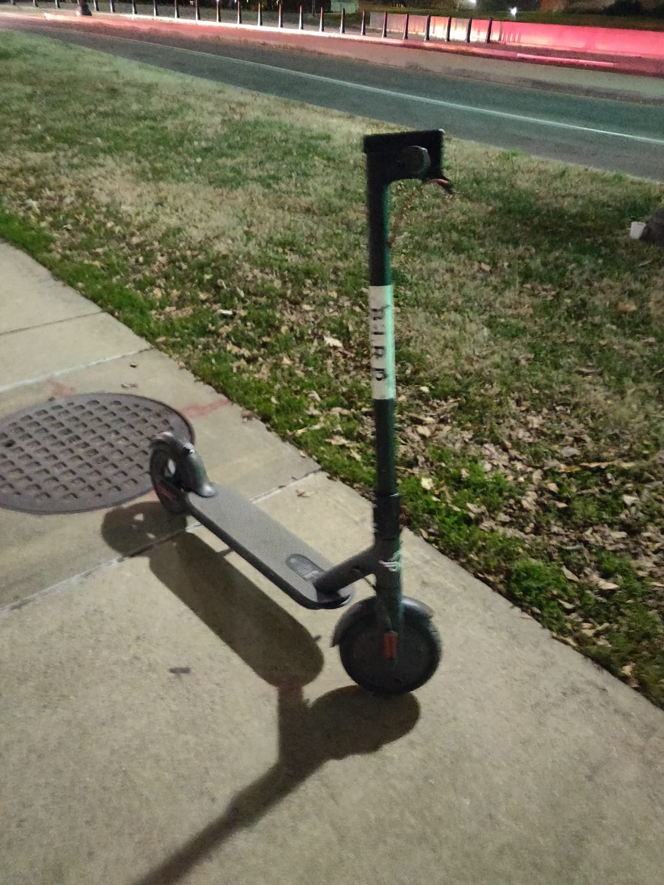
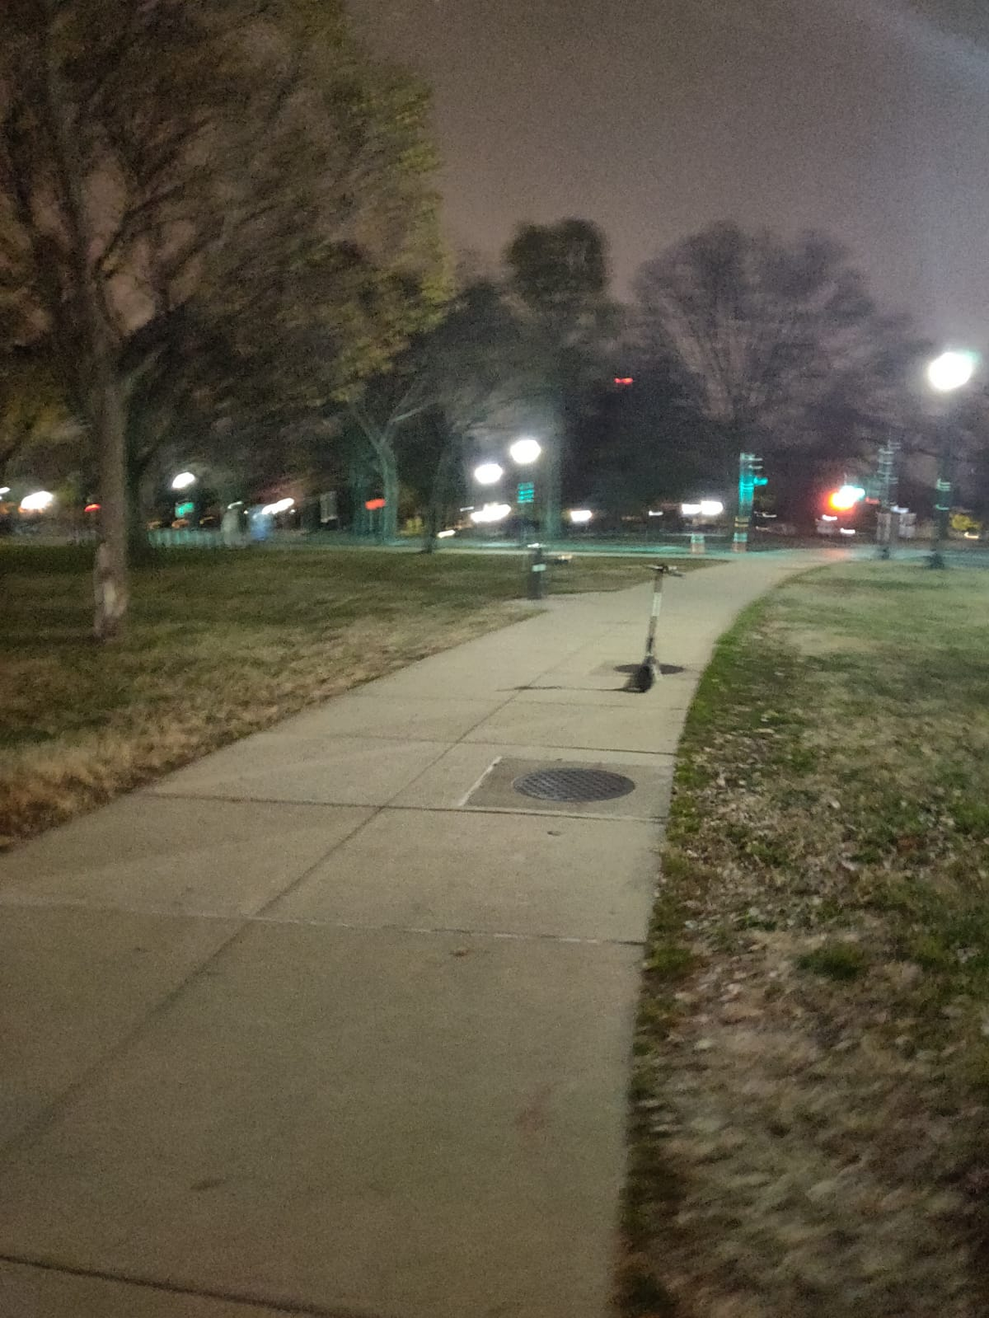
BIRD Scooter Found Near Lincoln Memorial

Slide 33
Weather Impacts
Weather Impacts:
The visualizations show that whenever there is a drop in temperature, the trip durations drop and so do the number of trips.
Our Recommendation: We recommend that Seattle Bike Sharing can offer some coupons or rewards for longer rides taken, such as a coupon code for a free coffee on days that temperature drop below 50 Degrees, which is our most common threshold, below which ride durations and frequency take a hit.

Slide 34
References
City of Chicago Divvy (2018). 2018 Q2 Data [comma separated values file]. Retrieved from https://www.divvybikes.com/system-data.
Metro Bike Share (2018). 2018 Q2 [comma separated values file]. Retrieved from https://bikeshare.metro.net/about/data/.
Capital Bikeshare (2018). 201804-capitalbikeshare-tripdata [comma separated values file]. Retrieved from https://s3.amazonaws.com/capitalbikeshare-data/index.html.
Weather Underground (2018). Ronald Reagan National Airport. Retrieved from: https://www.wunderground.com/history/monthly/us/dc/washington/KDCA/date/2018-4
Weather Underground (2018). ABNFX Station. Retrieved from: https://www.wunderground.com/history/monthly/us/il/chicago/KILCHICA123/date/2018-5
Weather Underground (2018). Los Angeles Downtown Station. Retrieved from: https://www.wunderground.com/history/monthly/us/ca/los-angeles-downtown/KCQT/date/2018-4
Harris, M (2018). The Bike war is shaking up Seattle like nowhere else. Wire. Retreived from: https://www.wired.com/story/the-bike-share-war-is-shaking-up-seattle-like-nowhere-else/
Seattle Department of Transportation (2018). 2017 free-floating bike share pilot evaluation report. Retrieved from: https://www.seattle.gov/Documents/Departments/SDOT/BikeProgram/SDOTBikeShareEvaluationReport2017.pdf

